Slide 1
INTEGRATED ELECTION EXPENDITURE MONITORING SYSTEM
Thiru. SATYABRATA SAHOO I.A.S., CHIEF ELECTORAL OFFICER
TAMIL NADU
https://iems.eci.gov.in

Slide 2
Objective of IEMS
Easy Monitoring & Management
Easy to Use
Unified Portal
User friendly etc.

Slide 3
IEMS Key Modules
Contribution Report (Form 24A)
Annual Audit Accounts
Election Expenditure – Part & Full

Slide 4
IEMS Stakeholders
ECI
Monitoring & On boarding of all political parties
Ensure compliances of recognised political parties.
Manage Due date of all reports
CEO
Ensure compliance report (24A, AAA & EE (Full & part) of RUPPs
Digitalization backend data feeding of RUPPs
Reminders
Political Parties
Online submission of all reports (AAA, Form-24A & EE) using IEMS
Regular alerts & reminders on registered e-mail & phone No.

Slide 5
Introduction IEMS Application is a user-friendly, secure online platform which enables Political Parties to submit online prescribed compliance documents like- Report Format Links : • Contribution Report (Form 24A) • Annual Audited Accounts • Election Expenditure Statement (Part) • Election Expenditure Statement (Final) Political Parties will be able to access the portal by doing login with Username, Password and OTP, which will be provided by Election Commission of India. ECI will provide default password which can be changed after first login. Key Features of IEMS User Manual • User friendly and well-designed online Application. • Easy to monitor status of filing and already filed reports. Software Requirements & Compatibility IEMS web application is compatible with various Operating Systems and Web Browsers. The list of the compatible Operating Systems & Web Browsers may be seen below:

Slide 6
Compatible Operating Systems & Recommended Version • Windows (Windows 10+) • Mac (macOS 11+) • Linux (Ubuntu LTS releases 18.04 or later) Compatible Web Browsers & Recommended Version • Chrome (v110+) • Firefox (v102+) • Safari (v16.2+) • Microsoft Edge (v110+) • Internet Explorer (IE11) Getting Started Credentials of Political Parties such as name of Political Party, registered address, authorized signatory, Mobile No., and E-mail id, etc. will be generated by the Election Commission of India based on the records of the Political Parties available in ECI. The Political Parties shall use these credentials to file their above mentioned Financial Reports. If any Political Party does not find their credentials updated or in case of any discrepancy, they should make a request with all their records to the ECI for updating credentials and after due verification it will be updated by the ECI. Political Parties are advised to communicate promptly in case of any change occurring in any of the credentials well in time to the ECI to avoid any inconvenience in filing of their duly authorized financial reports.

Slide 7
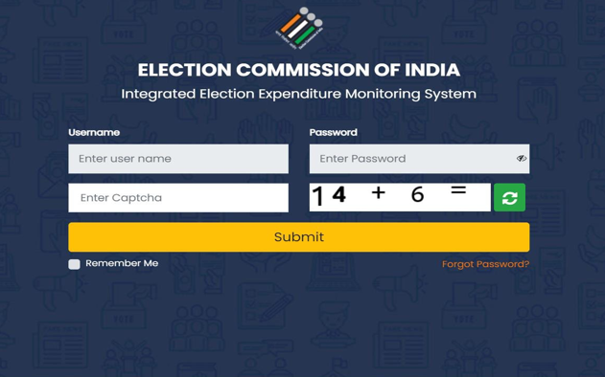
Login to the Application
• Navigate to https://iems.eci.gov.in/
• Enter Username, Password, Captcha and click on Submit

Slide 8
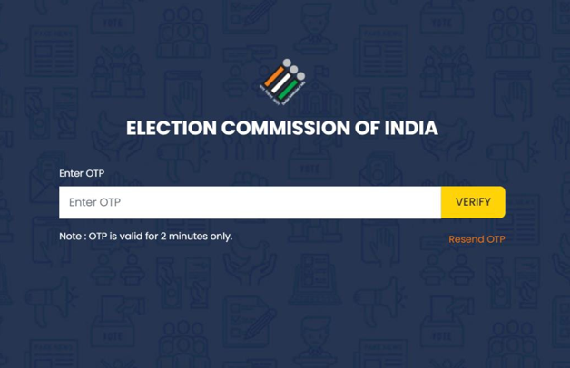
• Enter the OTP received and click on Verify.
• Note: The OTP will be valid only for 2 minutes.
• If you don’t receive the OTP, please click on Resend OTP.

Slide 9
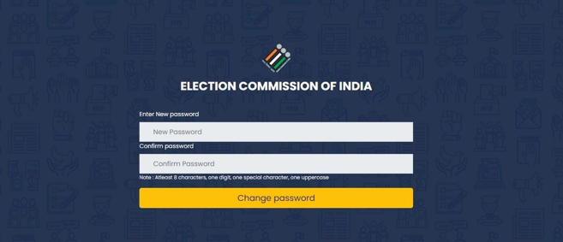
• If you are doing the login for the first time, Reset/Change the password.
• Note: The password must contain at least 8 characters, with at least one digit, one special character and one uppercase.

Slide 10
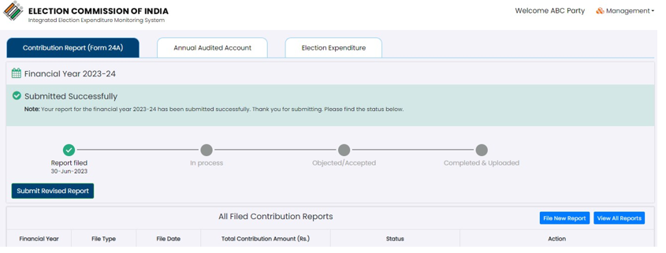
• After successful login, Dashboard will appear.

Slide 11
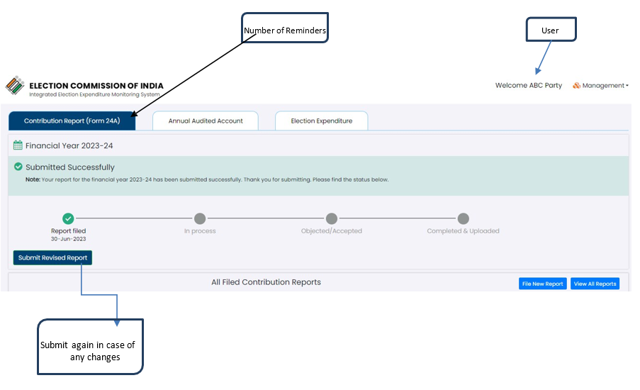
Dashboard Overview

Slide 12
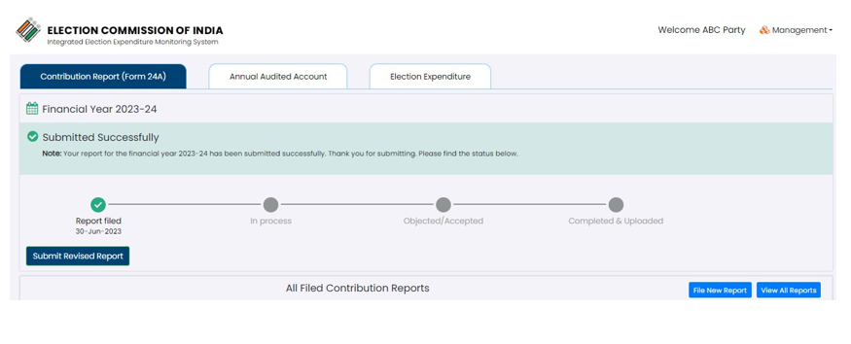
• Contribution Report (Form 24A) will be selected by default.
• Latest Financial year report status will be displayed on top with details like date of filing, processing status etc.
• You can resubmit the report by clicking on the “Submit Revised Report” button for that financial year.

Slide 13
All Filed Contribution Report
• Here you can view all the financial year reports with all the details like File type, Total contribution amounts (In Rupees), Status etc.

Slide 14
• On hovering, you can view the status of respective financial year reports like when it was filed, in process, objected/ accepted or completed.
• You can submit the report again in case of any changes by clicking on the “Revise Report” button for the respective financial year.
• If you want to download the report, please click on “Download Report” button which will download the report for that financial year in a PDF format.
Reminders/Alerts
Suitable alerts on registered mobile numbers and email will be sent periodically, before due date at different intervals to remind political parties to file compliance reports before due date, so as to avoid any consequential action

Slide 15
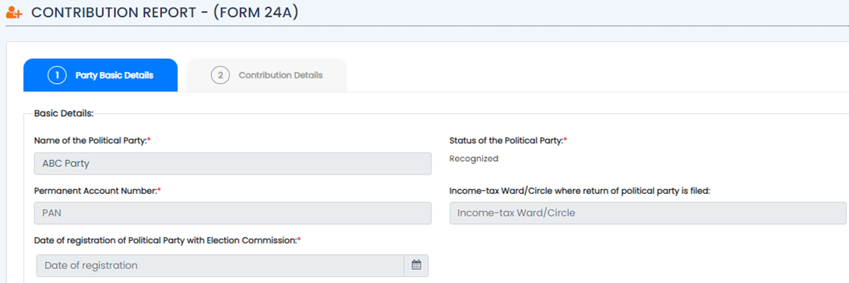
Steps to Submit a new Contribution Report (Form 24A)
• Go to All Filed Contribution Report and Click on “File New Report” button for Contribution Report (Form 24A).

Slide 16
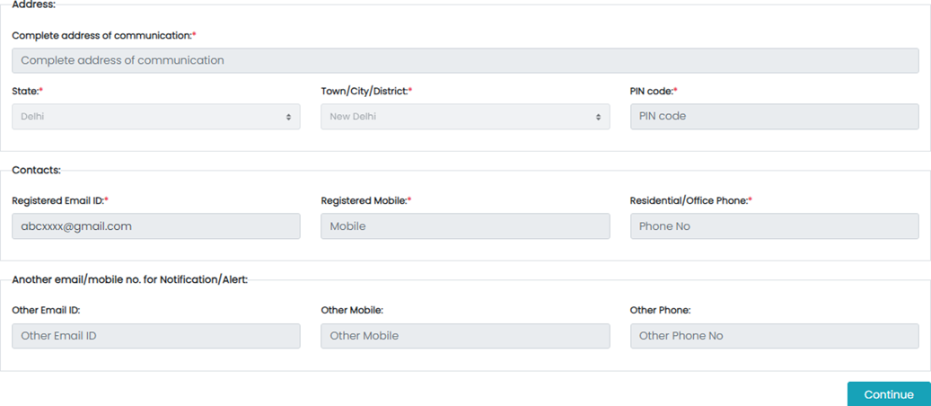
• Here in the Tab-1, you can see all the basic details of your party.

Slide 17
• Click on the Tab-2 (Contribution Details) to add new Contribution Report.
• Select Financial Year from the dropdown for which you want to submit the Contribution Report.
• Then Click on “+Add Contribution” button to add.

Slide 18
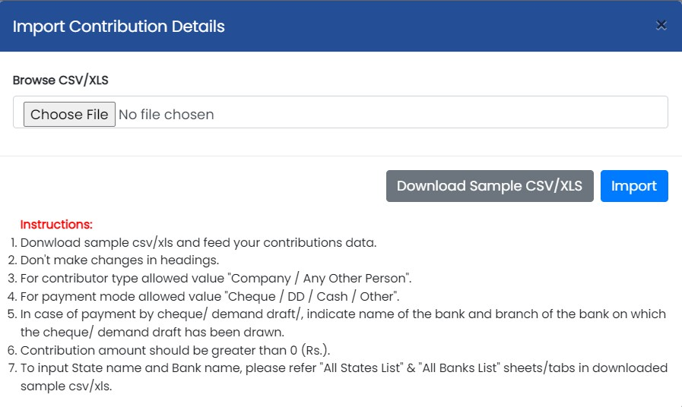
Read the Instructions carefully.
Click on “Download Sample CSV/XLS” button to download a sample format. Below attached is a sample format.

Slide 19
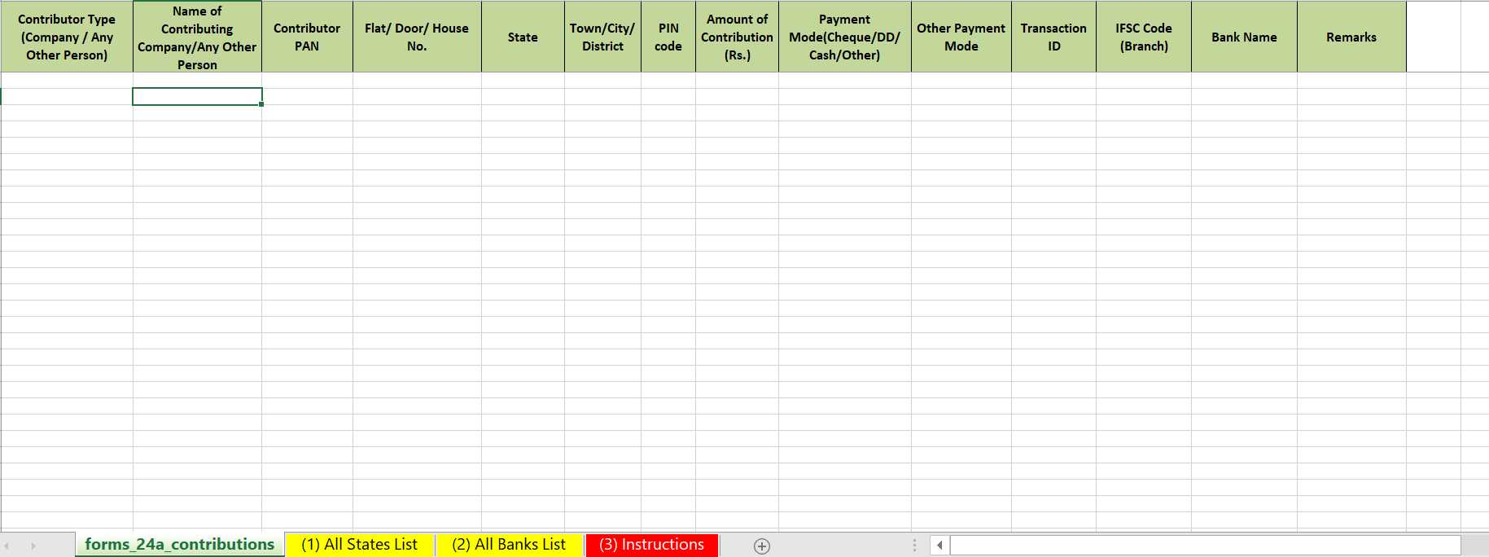
Fill your contributions data in the above format, save it
Click on ”Choose File”, select the file which you have saved with all your contributions data
Then click on button.

Slide 20
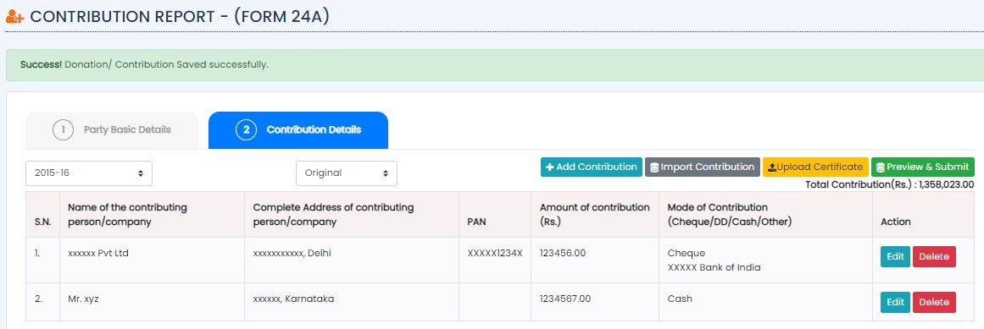
After importing successfully, Click on “Upload Certificate” Button to upload certificate (A copy of the certificate to this effect obtained from the company should be attached).
Multiple files can be uploaded at once.

Slide 21
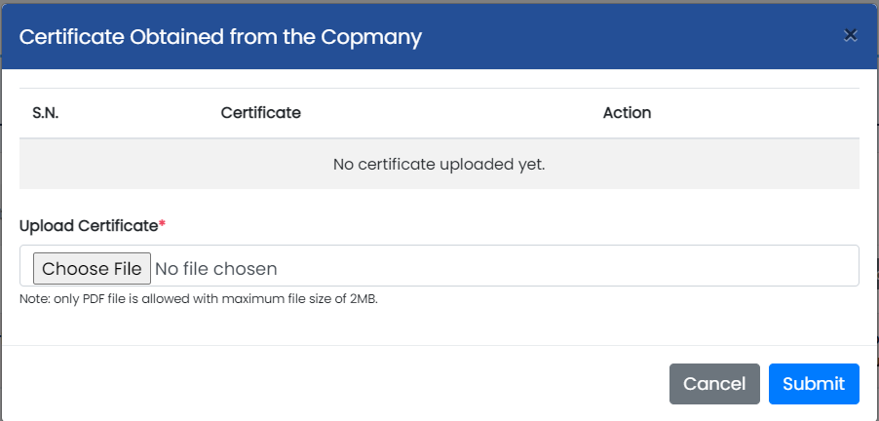
Click on “Choose File” and select the certificate which you want to upload.
Note: Only PDF file is allowed with maximum file size of 2MB.
After selecting the file, you can click on “View” button to View the certificate you uploaded.
If you want to delete the uploaded one and select a new one, you can click on “Delete” button and follow the same steps to add a new one.
Then Click on “Submit” button.

Slide 22
Click on ”Preview & Submit” button to see preview and further process to submit the Contribution Report.

Slide 23
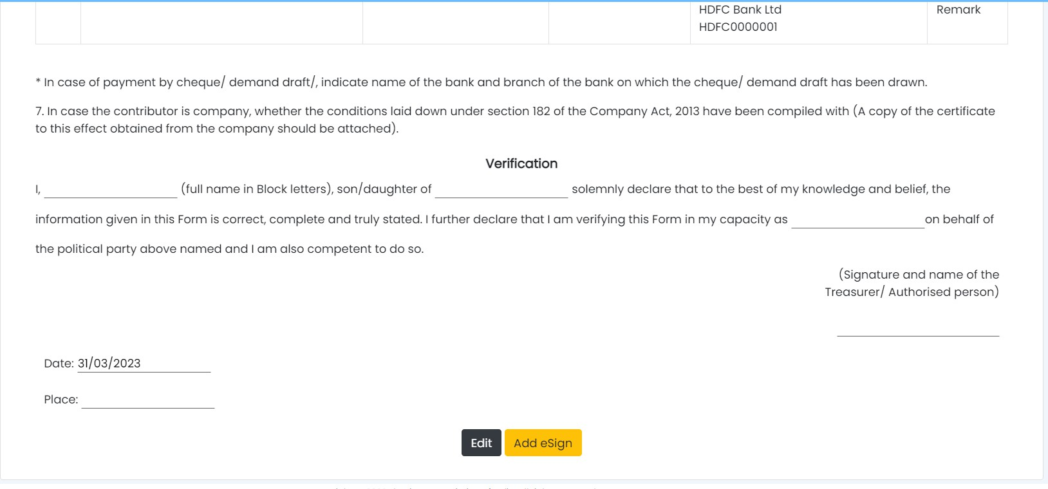
Here you can preview all the details you have entered in all the previous steps.
Signatory information- like name, father’s name, designation etc. should also be filled.
Signing date will be picked automatically.
Verify whether all the details are correct or not. If not, Click On “Edit” button to edit the details.
If the details entered by you are correct, fill the verification details like Name, Date, Place etc. and click on “Add e-Sign” Button to proceed further.

Slide 24
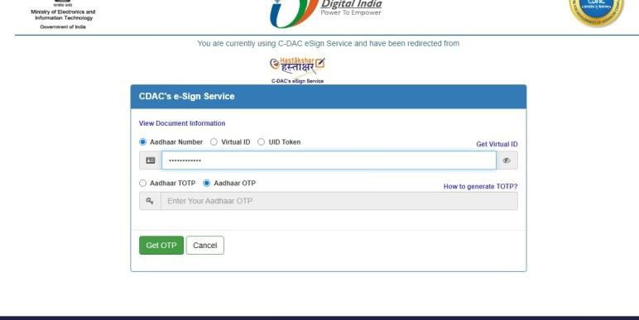
Select “Aadhar Number” and enter the Aadhar Number of the Auditor.
Then select “Aadhar OTP” and click on “Get OTP” button

Slide 25
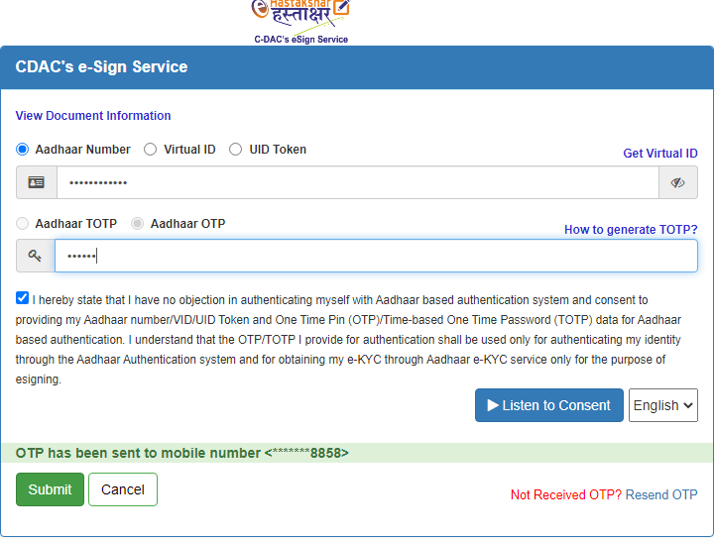
Enter the OTP received.
Click on the checkbox to agree to the ‘Consent’ and then click on “Submit” button to Proceed.

Slide 26
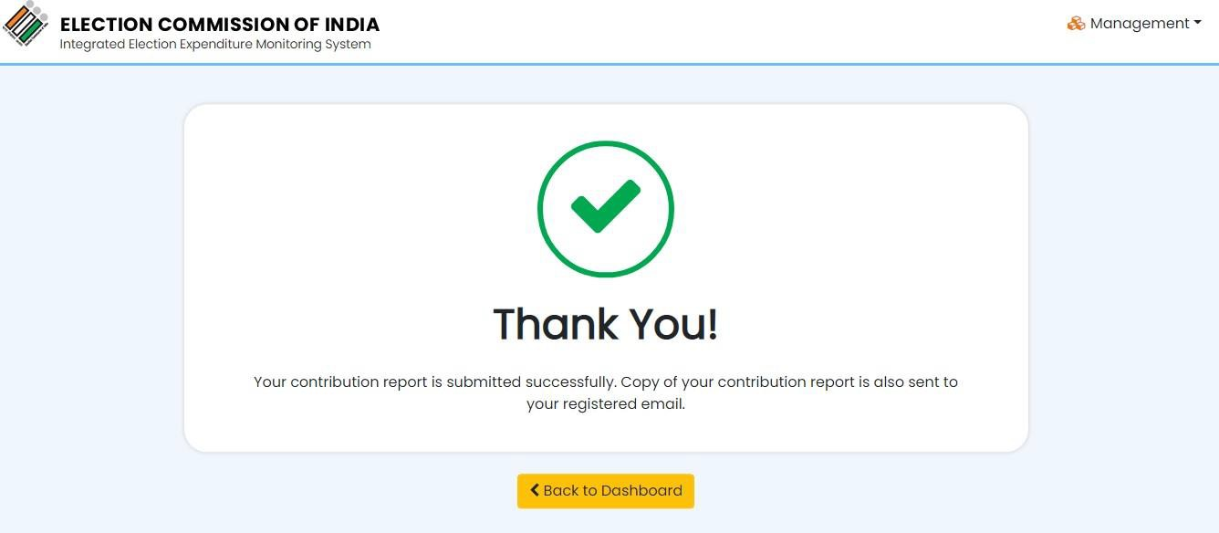
You will get a successful message that your report has been submitted successfully.

Slide 27
Annual Audited Account (AAA)
Political parties are required to submit their Audited Annual Accounts within 01 month from the last date for filing of ITR for political parties as per section 139 of Income Tax Act from FY 2020-21.
Annual Financial Account is to be prepared at the end of Financial Year i.e. 31st March every year. Balance Sheet is a one document out of the complete set of financial statement which comprises:
Balance Sheet,
Income & Expenditure Statement
Cash Flow Statement
Schedule / Notes to account and
Statement of adopted significant accounting policies.
The Institute of Chartered Accountant of India (ICAI) has issued a Guidance Note on Accounting and Auditing of Political Parties – 2012, which should be followed by every political party while preparing its Annual Accounts.Every schedule has two columns – one for current year and second for last year. In current year column, party has to report current year financial figures along with opening balance. If the party has already submitted annual audited report in online mode than opening balance will be filled automatically, otherwise party will have to fill it manually.

Slide 28
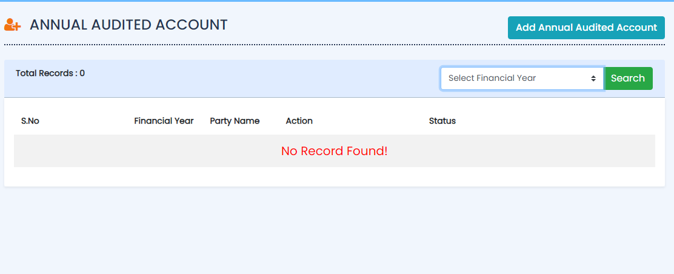
Step by step process for filing Annual Audited Account have been demonstrated here
Click on “Annual Audited Account” button from the Management dropdown to visit the Audited Report page.
Click on “Add Annual Audited Account” button to submit a new report.

Slide 29
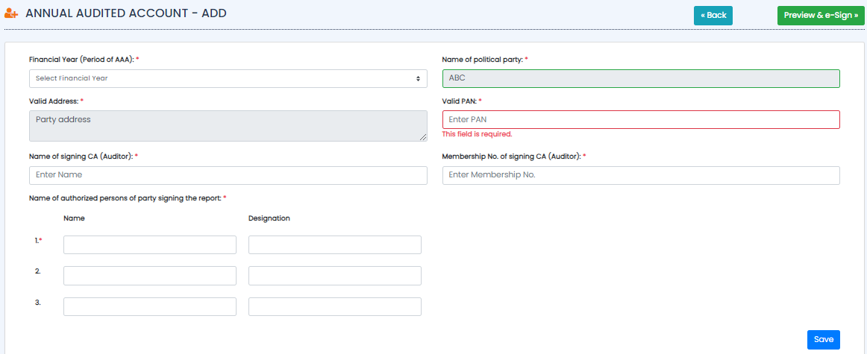
Party Basic Details
If any party wants to update any information about its party like communication address, authorized signatory, designation, and registered e-mail / phone no. etc., the party should communicate it to ECI.
Here you can select the financial year and fill the party Details.
Then click on “Save” button to save the details.
Fields with *mark are mandatory i.e, if you don’t fill those fields, you won’t be able to save the details.

Slide 30
Balance Sheet
Balance sheet of a political party is the document which shows the financial position at the end of each financial year i.e. 31st March. Balance sheet has total 10 schedules. Each schedule has been explained in this manual.
Sources of Funds
Sources of fund have six schedules which are as under
1. Corpus Fund, 2. General Fund, 3. Earmarked Fund, 4. Reserves, 5. Loans/Borrowings and 6. Current Liabilities & Provisions.
1. Corpus Fund
Corpus Fund (Schedule -1) is a fund which is of permanent nature / capital nature. Detailed accounting treatment has been mentioned in the ICAI Guidance Note-2012.

Slide 31
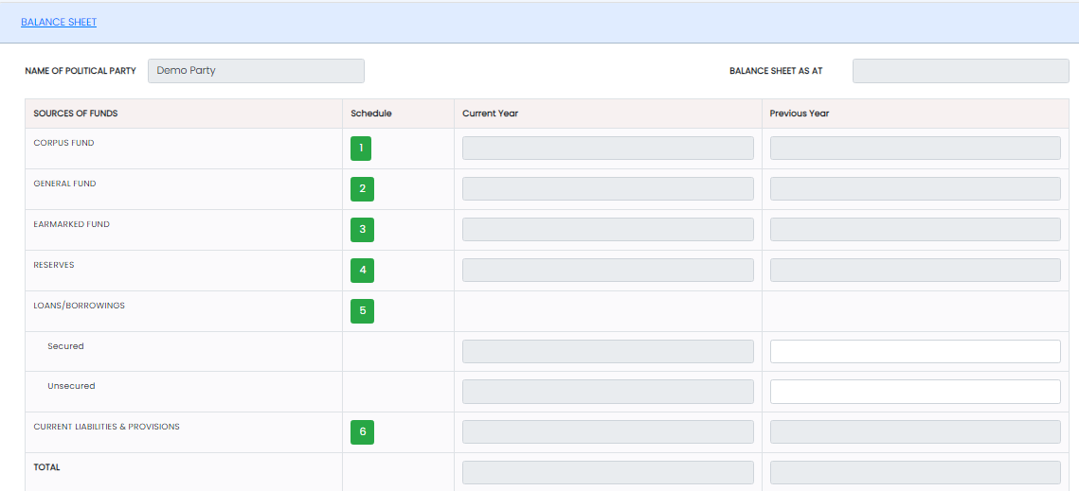
Balance Sheet
Click on under the schedule tab.

Slide 32
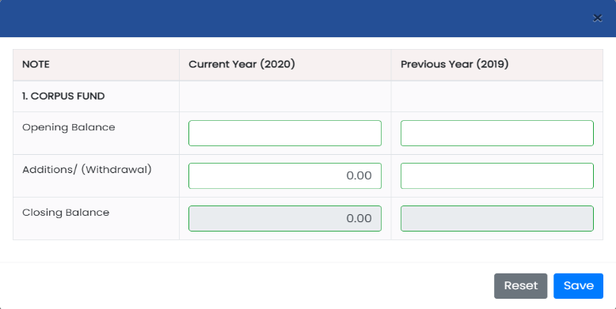
Fill all the required details like Opening Balance, Additions/ (Withdrawal) for both Previous year and Current Year.
Closing Balance for both the years will get updated automatically as per the data you have entered in the required Fields.
Click on “Reset” button to reset the details entered and enter details again.
Click on “Save” button to save the details.

Slide 33
After saving the details, balance for the previous year and Current year will get updated for the corpus fund.

Slide 34
2. General Fund
Click on under the schedule tab.

Slide 35
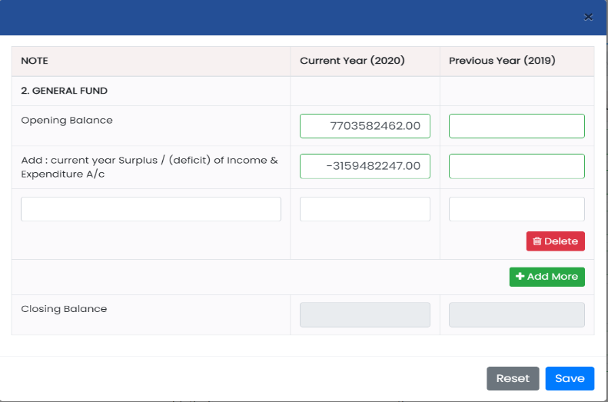
Fill all the required details like Opening Balance, Current Year surplus / (deficit) of Income & Expenditure A/c for both Previous Year and Current Year.
Click on “Delete” button to delete the details you want to.
Click on “+Add More” button to add more details.
Closing Balance for both the years will get updated automatically as per the data you have entered in the required Fields.
Click on “Reset” button to reset the details entered and enter details again.
Click on “Save” button to save the details.

Slide 36
After saving the details, balance for the previous year and Current year will get updated for the General fund.

Slide 37
3. Earmarked Fund
Earmarked Fund (Schedule -3) this is the fund which is made for specific purpose other than the reserves reported under the schedule -4 “Reserve”. Every type of Earmarked fund should be reported separately with opening, adjustment & closing balance. A free text area has also been given to report material facts and mandatory disclosures.
Click on
under Schedule tab.

Slide 38
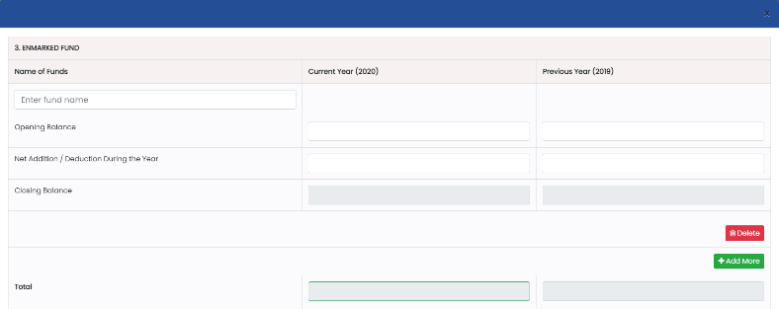
Fill all the required details like Opening Balance, Net Addition / Deduction during the Year for both previous year and Current Year.
Closing Balance for both the years will get updated automatically as per the data you have entered in the Required Fields.
Click on “Delete” button to delete the details you want to.
Click on “+Add More” button to add more details.
Total for both the years will get updated automatically as per the data you have entered in the required Fields.

Slide 39
Enter Remarks (if any) in the text area.
Click on “Reset” button to reset the details entered and Enter details again.
Click on “Save” button to save the details.

Slide 40
After saving the details, balance for the previous year and Current year will get updated for the Earmarked fund.

Slide 41
4. Reserves
Reserve (Schedule -4) Party has to report here all reserves which have been created, including – Revaluation Reserve, Special / Statutory Reserves etc.
5. Loans/Borrowings
Loan / Borrowing (Schedule -5) Loan/borrowing have been divided into two categories – One is Secured loan and the Second one is unsecured loan. Both categories have been further sub-divided. Free text area for reporting of material facts and mandatory disclosures has also been given.
6. Current liabilities & Provisions
Current Liabilities & Provisions (Schedule -6) under this schedule party has to report all liabilities and provisions which are not covered under schedule – 1 to 5. Under this schedule, both – current and non-current liabilities are to be reported. Details about their treatment are in Guidance Note of ICAI-2012.
Application of Funds
Application of Fund: All political party has to report its application of all funds in following four reporting heads, which have been prescribed in Guidance Note of ICAI -2012
Investment
Investment (Schedule -8) In this schedule, party has to report all investment in two groups –Long Term and Current Investment. A free text area has also been given to report all material facts and mandatory disclosures

Slide 42
Current Assets
Current Assets (Schedules -9) In this schedule, all current assets have to be reported into following four groups – Inventories, Receivables, Cash & Cash Equivalents and Other Assets. A free text area has been given to report all material facts and mandatory disclosures also.
Fill the inventories details in section (i) for both the previous year And current year.
Click on “Delete” button to delete the details you want to.
Click on “+Add More” button to add more details.”
Total for the inventories will get updated automatically in the Total(i) field.

Slide 43
Fill the Receivables details in section (ii) for both the previous year and current year.
Click on “Delete” button to delete the details you want to.
Click on “+Add More” button to add more details.”
Total for the Receivables will get updated automatically in the Total (ii) field.

Slide 44
Fill the Balance with Scheduled Bank details in section (iii) under Cash & Cash Equivalents for both the previous year and current year.
Click on “Delete” button to delete the details you want to.
Click on “+Add More” button to add more details.”
Fill the Balance with Non-Scheduled Bank details in section (iii) under Cash & Cash Equivalents for both the previous year and current year.
Click on “Delete” button to delete the details you want to.
Click on “+Add More” button to add more details.”
Total of Sch-9(iii) should be equal to the closing balance of Cash Flow Statement.

Slide 45
Income and Expenditure Account
Income and Expenditure Account is to be prepared as per the prescribed format, which has been given in Guidance Note of ICAI on Accounting & Auditing of Political Parties -2012.
Income
Grants/Donations/Contributions
Collection by Issuing Coupons/Sale of Publications
Other Income
Expenditure:
All expenditures will be reported in six prescribed reporting heads which have been mentioned in ICAI Guidance Note-2012- 1. Election Expenditure, 2. Employee Costs, 3. Administrative and General Expenses, 4. Finance Costs, 5. Depreciation & Amortization Expenses and 6) Other expenses. Party has to report all expenditure, which is incurred in that Financial Year. Schedule wise disclosure are being illustrated below –
Election Expenditure:
Finance Costs:
Depreciation & Amortization Expenses:
Other Expenses:

Slide 46
Notes on Accounts:
Notes to the accounts are the details and the comment on the information presented in the Balance Sheet, Income & Expenditure Account and Cash Flow Statement. Notes to the accounts reflect the accounting principles and the material facts. It includes assumptions made by management when preparing the annual financial statement.
In the political party’s notes on account, some pre-filled points have been given on which political party has to provide required information. However, these points are not exhaustive and the party may disclose other points as well.
There are multiple schedules under Schedule 21 i.e.,
Significant contributions / donations/ collection from issuance of coupons exceeding Rs 5,00,000/- to any individual or any other party (21.1)
Donation received from outside India (21.2)
Penalties on electoral offences along with the material electoral offence (21.3)
Banks Details (21.4)
Details of total donation received in cash & non cash (21.5)
Other Notes on Accounts (21.6)

Slide 47
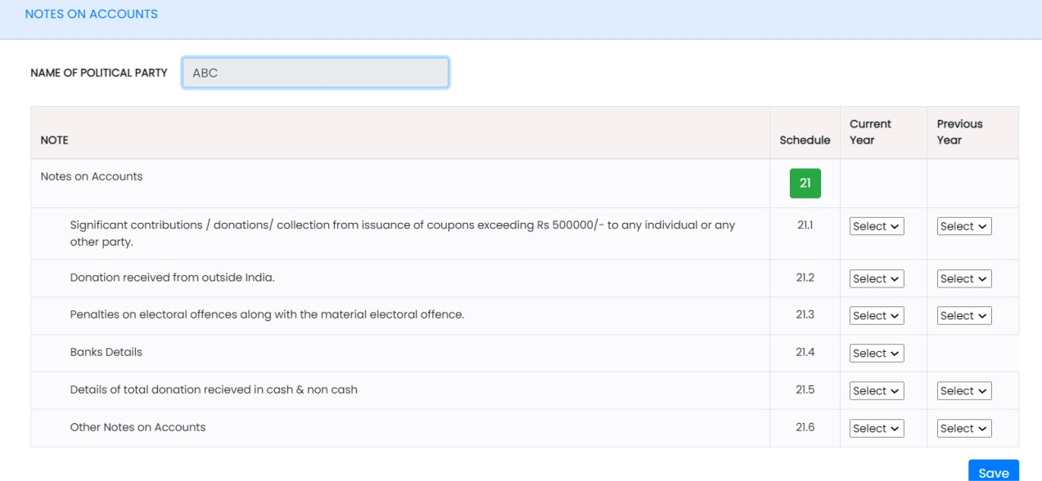
Significant contributions / donations/ collection from issuance of coupons exceeding Rs 5,00,000/- to any individual or any other party (21.1):
Political party has to disclose significant donor’s (donated more than 5 lacs rupee) details in prescribed format. Format has been given in SN -21.1. The details can be uploaded in CSV/XLS file.

Slide 48
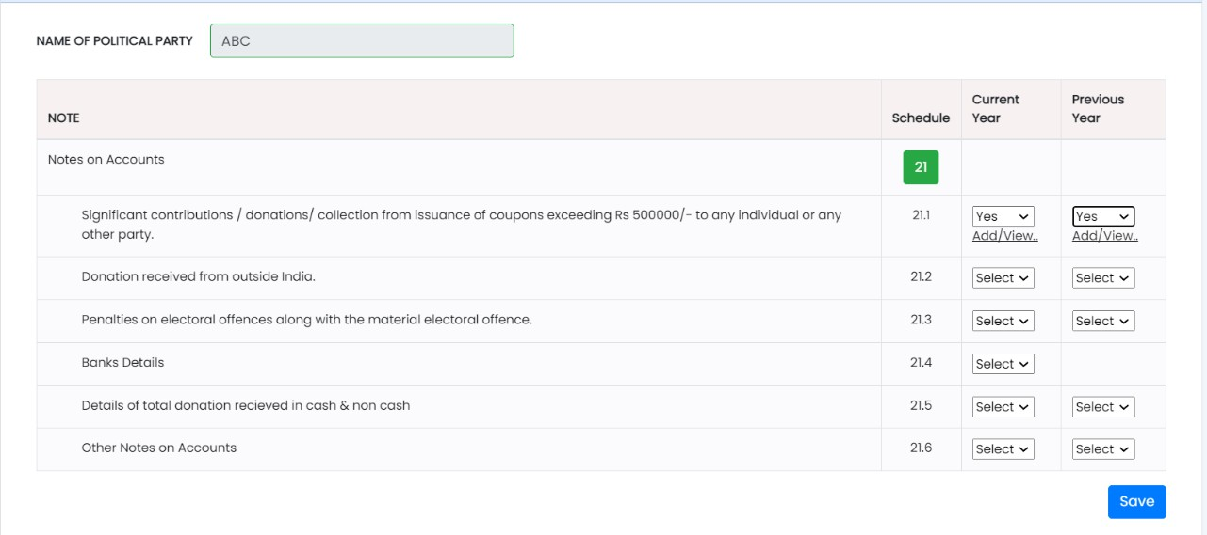
If you choose “YES” from the dropdown in the year tab, you will be able to see another option below to the Dropdown i.e, Add/View.

Slide 49
Donation received from outside India :
Penalties on electoral offences along with the material electoral offence
Banks Details
Details of total donation received in cash & non cash
Other Notes on Accounts

Slide 50
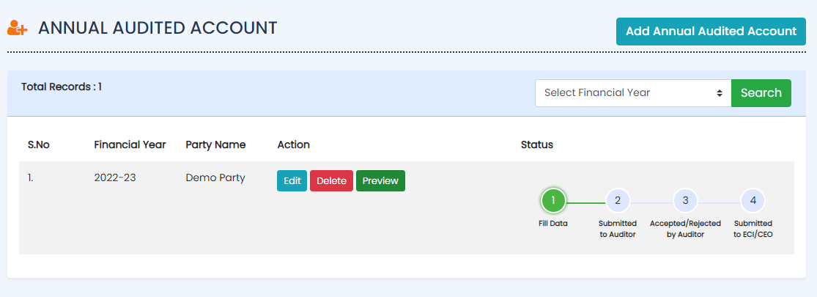
Cash Flow Statement
Click on “Preview” button to see preview of annual audited account report.

Slide 51
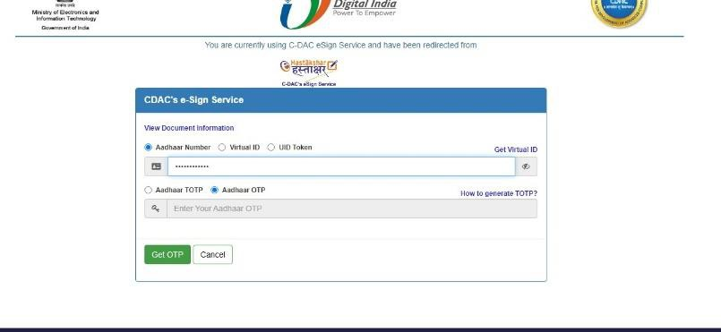
Select Aadhar Number & enter the registered Aadhar Number of any one of the signatories
Select Aadhar OTP and click on “Get OTP” button.

Slide 52
Enter the OTP received and agree to the consent by clicking on the checkbox.
Click on “Submit” button to submit.

Slide 53
Annual Audited Report will be submitted to auditor successfully and status of report will be changed.
Now Auditor will login in to the portal with the credentials and Click on “Annual Audited Account” from the dropdown.
Click on “Annual Account” button to review report.
Click on “Download” button to download annual account.

Slide 54
On pressing “Reject” button, this dialogue box will appear in which Auditor can write the Reason of Rejection and submit it.
Once rejected, user has to resubmit the report by filling all the details again from the starting by following the same steps

Slide 55
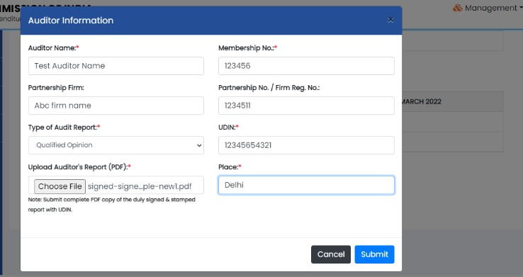
On pressing “Accept” button, this dialogue box will appear in which Auditor has to fill all the details like Name, Place etc. and submit it.
Auditor has to upload his auditor report duly signed & stamped in pdf format.
After submitting, it will redirect to the e-Sign page in which Auditor has to add e-Sign.

Slide 56
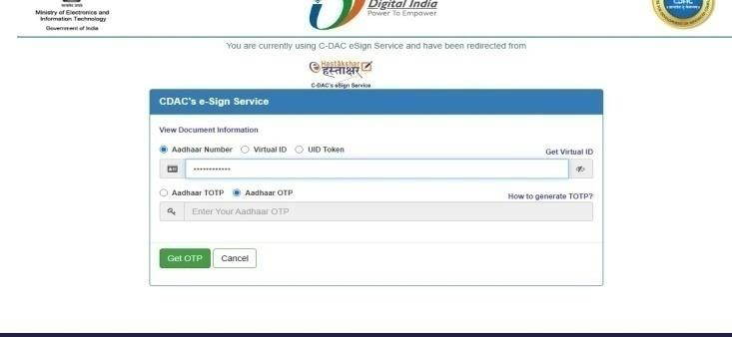
Select “Aadhar Number” and enter the Aadhar Number of the auditor.
Select ”Aadhar OTP” and click on “Get OTP” button

Slide 57
Enter the OTP received.
Click on the checkbox to agree the Consent and then click on “Submit” button to Proceed.

Slide 58
Annual audited account report will be accepted and status will change as “Accepted by Auditor”.
Once the Status will change to “Accepted by Auditor”, user can submit report to ECI/CEO.

Slide 60
Election Expenditure Statement
Political Parties are required to file Part Election Expenditure Statement within 30 days of declaration of election result and Full Election Expenditure Statement within 75/90 days of completion Assembly/ Lok Sabha Election.
Click on “Election Expenditure” button from the management dropdown to visit the Election Expenditure page.
After login to political party user will redirect to Election Expenditure page.
Then click on “Part Expenditure Statement” to start the report of Expenditure.

Slide 61
Part Election Expenditure Statement:
Political parties are required to file a part statement on election expenditure regarding lump sum payments made by the party(ies) to candidates, within 30 days after declaration of results of elections to Legislative Assembly/Lok Sabha in prescribed format. National and State Recognized Political Parties are required to submit their Election Expenditure Statement with the ECI, New Delhi and Registered Unrecognized Political Parties (RUPPs) are required to submit their Election Expenditure Statement with the Chief Electoral Officer of the State/UT concerned where the party Headquarter is located. The format consists of 07 columns as under:
Column1: Serial Number
Column 2: Name of the State/No. and Name of the Assembly and / or Parliamentary Constituency Column 3: Name of Candidate(s)
Column 4: Date(s) of payment Column 5: Cash amount
Column 6: Cheque/DD/PO/RTGS/Fund Transfer etc. Column 7: Total
When Click on “Part Expenditure Statement”

Slide 62
Statement of Election Expenditure – Schedules
(Details to be furnished in the format given in Schedule)
Schedule | Nature of expenses
Schedule-1 | State wise break up of Gross Expenditure authorized/ incurred by Party Central Head Quarters for general Party propaganda from the date of announcement of election to the date of completion of election
Schedule-2 | Travel expenses of Star Campaigner(s) authorized/ incurred by Party Central Headquarters
Schedule-2A | Travel expenses of Other leader(s) incurred/Authorized by Party Central Headquarters (including expenses after announcement and before nomination)
Schedule-3 | Expense(s) on Media Advertisement (print and electronic, bulk sms, cable, website and TV Channel etc. )on General Party propaganda authorized/ incurred by Party Central Head Quarters
Schedule- 4 | Expense(s) on Publicity Materials including posters, banners, badges, stickers, arches, gates, cutouts, hoardings, flags etc for general party propaganda authorized/ incurred by Party Central Head Quarters
Schedule- 5 | Expense(s) on Public meetings /procession/Rally ( like dias / audio/ barricade/ vehicles etc.) authorized/incurred by Party Central Headquarters
Schedule- 6 | Any other expense(s) for General Party propaganda authorized/ incurred by Party Central Head Quarters
Schedule- 7 | Total lump sum payment (s) to Candidate(s) of the party or other candidate(s) if, any authorized/ incurred by Party Central Head Quarters, either in cash or by Instruments like- cheque/ DD/PO/RTGS/Fund Transfer etc. If political party makes payment (s) to candidate(s) on more than one occasion then date wise details are to be mentioned.
Schedule- 8 | Total Expense on Media Advertisement (print and electronic, bulk sms, cable, website, TV Channel etc.) for specific candidate(s) with photo or name of candidate or attributable to any candidate(s) authorized/ incurred by Party Central Headquarters

Slide 63
Schedule -9 | Total expense on Publicity Materials (like posters, banners, election materials etc) with photo and/or name of the candidate(s) or attributable to candidate(s) and authorized/ incurred by Party Central Headquarters
Schedule- 10 | Total Expense authorized / incurred by Party Central Headquarters (Other than general party propaganda) on Public meetings /processions etc (barricades /audio etc /hired vehicles for the audience /supporters at the rally of Star Campaigner(s) or other leaders with candidate(s)
Schedule- 11 | Any other expense(s) for the candidate(s) authorized/ incurred by Party Central Headquarters
Schedule 12 | Travel expenses of Star Campaigner(s) authorized / incurred by State / Distt. / Local Units
Schedule 13 | Travel expenses of other leader(s) authorized / incurred by State / Distt. / Local Units (including expenses after announcement and before nomination)
Schedule 14 | Expense(s) on Media Advertisement (print and electronic, bulk sms, cable, website and TV Channel etc.) on General Party propaganda authorized / incurred by State / Distt. / Local Units
Schedule 15 | Expense(s) on Publicity Materials i nclu ding posters, banners, badges, stickers, arches, gates, cutouts, hoardings, flags etc for general party propaganda authorized / incurred by State / Distt. / Local Units.
Schedule 16 | Expense(s) on public meetings / procession / Rally (like dais / audio /barricade /vehicles etc.) authorized / incurred by State / Distt. / Local Units

Slide 64
Schedule 17 | Any other expense(s) for General Party propaganda authorized / incurred by State / Distt. / Local Units
Schedule 18 | Total lump sum payment(s) to Candidate(s) of the party or other candidate(s), if any authorized /incurred by State/ Distt. / Local Units, either in cash or by Instruments like – cheque / DD/PO/RTGS/Fund Transfer etc. If State /Distt. / Local Units makes payment(s) to candidate(s) on more than one occasion then date wise details are to be mentioned.
Schedule 19 | Total Expense on Media Advertisement (print and electronic, bulk sms, cable, website, TV Channel etc.) authorized / incurred by State/ Distt. / Local Units for specific candidate(s) with photo or name of candidate(s) or attributable to any candidate(s).
Schedule 20 | Total expense on Publicity Materials (like posters, banners, election materials etc) with photo and/or name of the candidates or attributable to candidate(s) authorized / incurred by State / Distt. / Local Units.
Schedule 21 | Total expense authorized/incurred for the candidate(s) by State / Distt. / Local Units (Other than general party propaganda) on Public m eeti ngs/ processions etc., (barricades /audio etc.,/ hired vehicles for the audience / supporters at the rally of Star Campaigner(s) or other leader(s).
Schedule 22 | Any other expense(s) for the candidate(s) authorized/ incurred by State / Distt. / Local Units
Schedule 23A | Total expenses incurred /authorized on publishing criminal antecedents, if any, of candidates sponsored by the political party located in Central Headquarters.
Schedule 23B | Total expenses incurred/ authorized on publishing criminal antecedents, if any, of candidates sponsored by the political party located in State/Distt. / Local Units.
Schedule 24A | Total expenses incurred/authorized on virtual campaign through Social Media platforms / Apps / Other means on General Party Propaganda authorized incurred by Party Central Head Quarters.
Schedule 24B | Total expenses incurred/ authorized on virtual campaign through Social Media platforms/ Apps/ Other means on General Party Propaganda authorized incurred by State / District / Local Units

Slide 65
THANK YOU

